Slide 1
CSE 433S: Introduction to Computer Security
Lecture 0: Fundamentals

Slide 2

First things first: Ethics!
ImgRef: Quora.com

Slide 3
Computer Security Ethics
This class is NOT “how to get hacker skillz 101” BUT…
We will study problems with existing systems
You will learn of tools to perform attacks and defenses

Slide 4
Computer Security Ethics
This class is NOT “how to get hacker skillz 101” BUT…
We will study problems with existing systems
You will learn of tools to perform attacks and defenses
As CSE professionals we use knowledge (legally) to benefit others
When in doubt, check with instructors
Computer crime is real crime with real consequences
– we will NOT back you up for “experimentation” outside the bounds of class

Slide 5
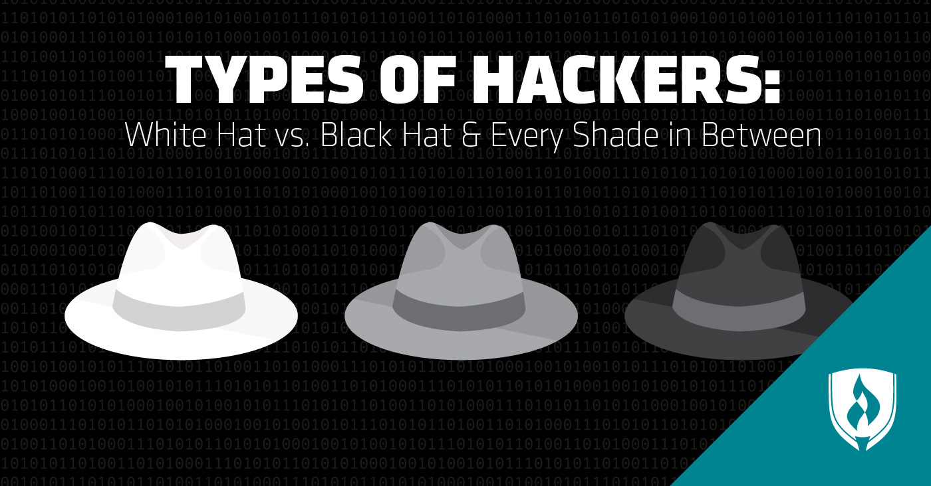
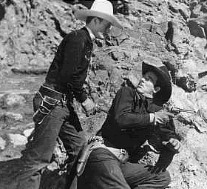
Computer Security Ethics
Regardless of whether Black Hat is your favorite XKCD character or conference, we will all be “white hats” here
https://meetmythamerica.wordpress.com/2014/08/04/white-hat-history/
https://www.rasmussen.edu/degrees/technology/blog/types-of-hackers/

Slide 6
Course learning objectives
Understand principles of secure system
Forming the foundation of secure communication (basic cryptography)
Understand the internals of existing attacks
Understanding the current landscape of security and privacy issues
Notes:
BREAK in videos

Slide 7
White/Blackboard Questions
Three key aspects of secure systems?
How do we secure my bank access from the app on my phone?
How do you secure a self-driving car?
Selection of Topics in the class

Slide 8
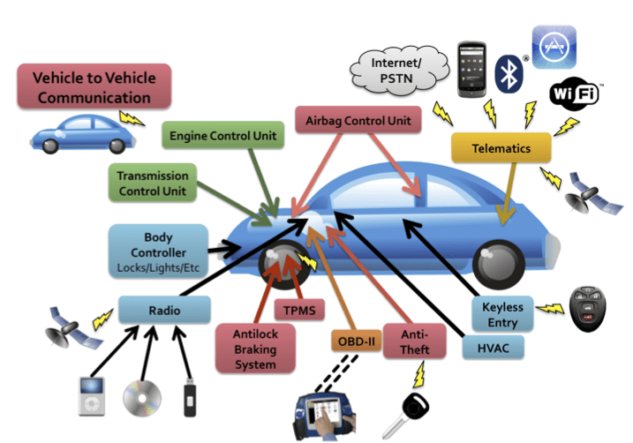
4. Modeling attacks
Attack surface example: cars
Checkoway et. al., USENIX 2011

Slide 9
Topics
Cryptography Introduction
Network Attacks
Attack lab
Symmetric Key
Stream cipher / block cipher
Hash Function
MD5 lab
Asymmetric Key
DH key exchange, RSA, digital signature
Network Security
PKI, HTTPS

Slide 10
Topics
Computer Systems
Software Attack and Defense
Buffer overflow lab
System Security
Security of Machine Learning
Machine Learning Security
Deep fake lab
Privacy
ChatGPT for security
Human Factor

Slide 11
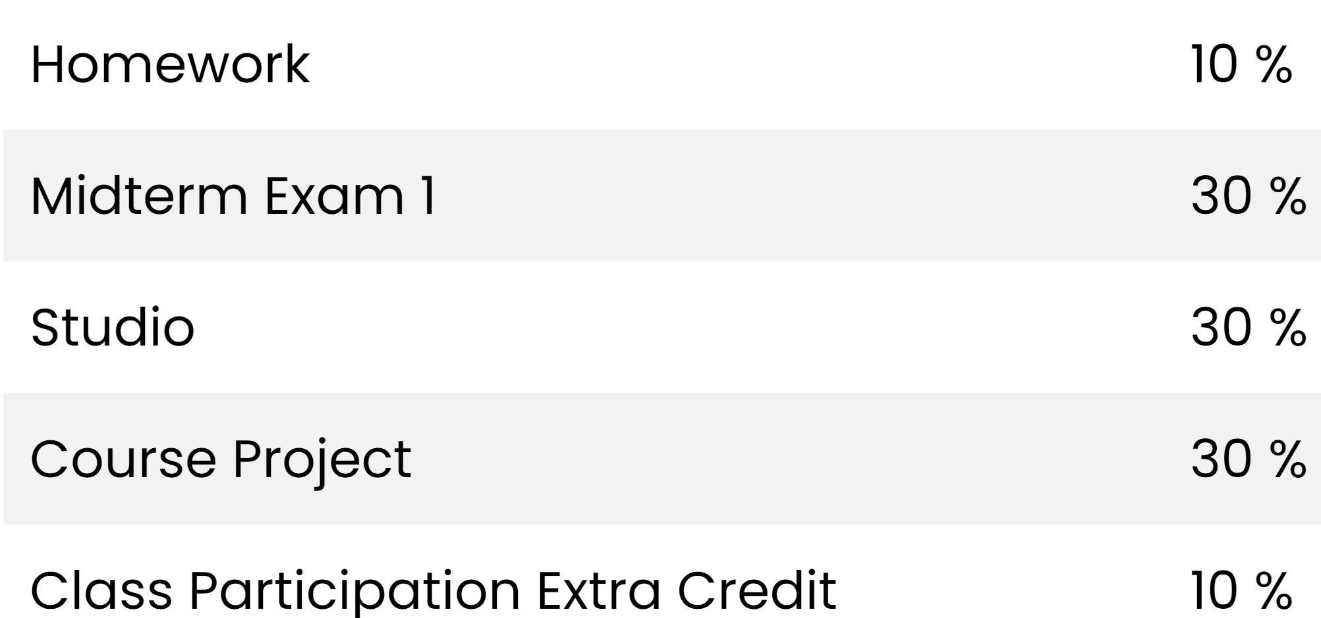
Grading

Slide 12
Studio
Homework
Use cryptography to secure communication
Studio
Network Attack – Spoofing
Crypto Attack
Symmetric cipher (cracking?)
MD5 hash collision
Software attack
Buffer overflow

Slide 13

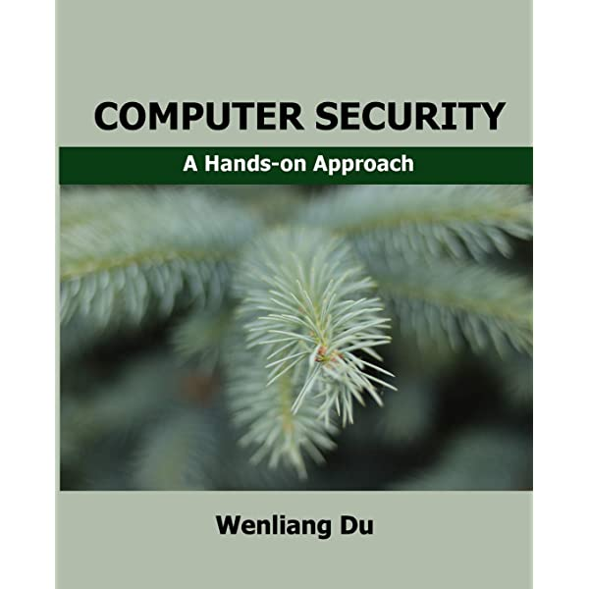
Optional Textbooks

Slide 14
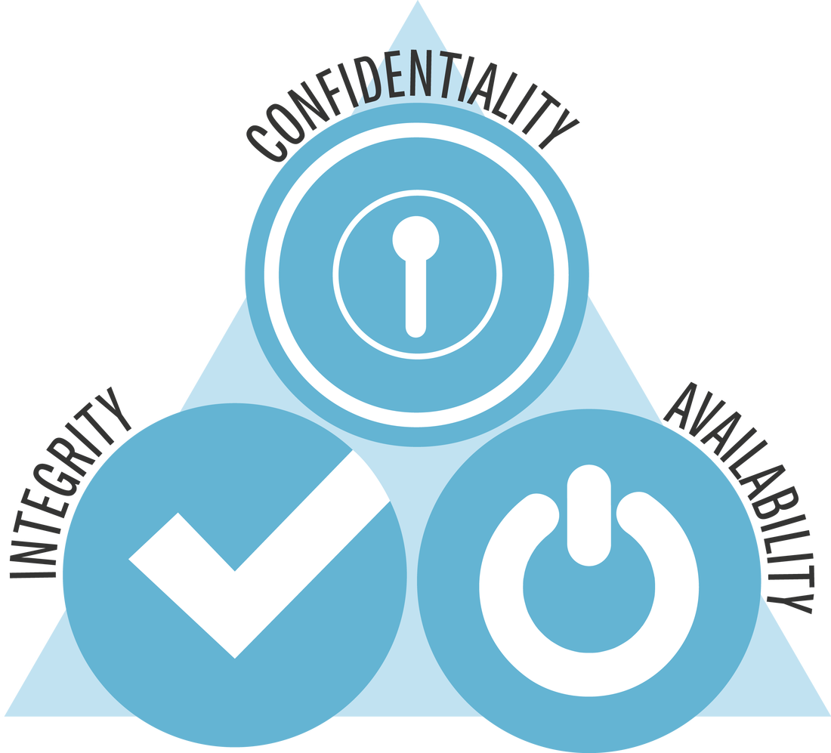
Key security concepts
C.I.A. triad
https://security6132.wordpress.com/2018/05/08/cia-triad/

Slide 15
Key security concepts
Confidentiality: no unauthorized disclosure of information

Slide 16
Key security concepts
Confidentiality: no unauthorized disclosure of information
Threat: eavesdropping
Alice
Bob
Eve

Slide 17
Key security concepts
Confidentiality: no unauthorized disclosure of information
Tools to achieve it
Encryption
Access control
Authentication (passwords, biometrics, etc.)

Slide 18
Key security concepts
C.I.A. triad
https://security6132.wordpress.com/2018/05/08/cia-triad/

Slide 19
Key security concepts
Integrity: information is not altered from original content in unauthorized way

Slide 20
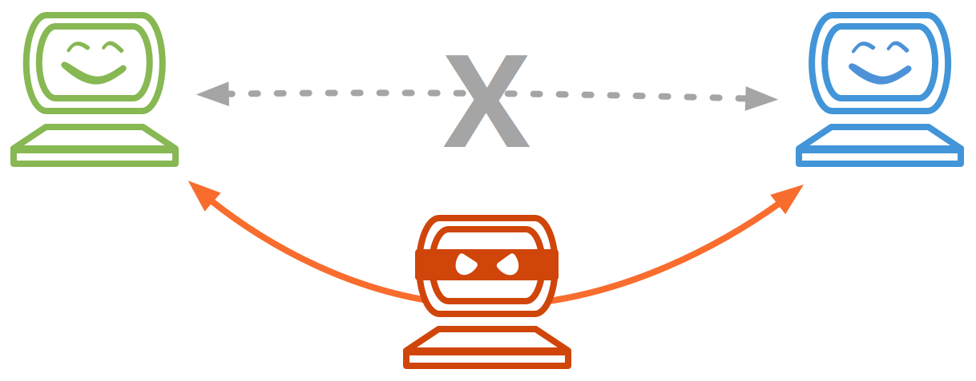
Key security concepts
Integrity: information is not altered from original content in unauthorized way
Threat: Man-In-The-Middle (MITM) or Person-In-The-Middle attack
https://docs.cpanel.net/knowledge-base/general-systems-administration/man-in-the-middle-attacks/

Slide 21
2. Key security concepts
Integrity: information is not altered from original content in unauthorized way
Tools to achieve it:
Backups (hot and cold, on-site and off-site)
Checksums and hash functions

Slide 22
Key security concepts
C.I.A. triad
https://security6132.wordpress.com/2018/05/08/cia-triad/

Slide 23
2. Key security concepts
Availability: information and resources are accessible to those authorized to have it

Slide 24
2. Key security concepts
Availability: information and resources are accessible to those authorized to have it
Threats:
Resource (e.g. website): Denial of Service (DoS or DDoS) attack
Example: Murai botnet makes popular websites unavailable (2016)
Video: Murai in 100 seconds
Example: DDoS attacks increase in work-from-home COVID-19 environment

Slide 25
2. Key security concepts
Availability: information and resources are accessible to those authorized to have it
Tools to achieve it:
backup power
isolated networks ("air-gapped systems")
no single point of data storage (e.g. RAID)
data backups
robust server infrastructure

Slide 26
2. Other security goals
Authenticity: identity of an entity (issuer of info/message) is verified

Slide 27
2. Other security goals
Authenticity: identity of an entity (issuer of info/message) is verified
Anonymity: identity of an entity remains unknown

Slide 28
2. Other security goals
Authenticity: identity of an entity (issuer of info/message) is verified
Anonymity: identity of an entity remains unknown
Non-repudiation: messages can’t be denied or taken back (e.g. online transaction commitments)
Notes:
BREAK

Slide 29
Acknowledgements
Slides contain material from Computer Security lectures taught by
Prof. Dan Boneh from Stanford
Prof. Wenke Lee from Georgia Tech
Prof. Wenliang (Kevin) Du from Syracuse
Profs. Zhang and Cole
These sources will be used for slides throughout the course

Slide 30
FAQ
https://cybersecurity.seas.wustl.edu/ning/teaching/F24cse433s/index.html
The class room limit is 50
No, this is probably not an easy class
Reasons to not take the class
Low level system details are not interesting to you
You don’t think security is important
We have final projects instead of final exams
i.e. there will be uncertainties

